Slide 1
Chatbots Development with Machine Learning
Machine Learning Architecture of Chatbots
Purpose of Machine Learning based Chatbots
Hands on: Rule Based Chatbots with Machine Learning and Python

Slide 2
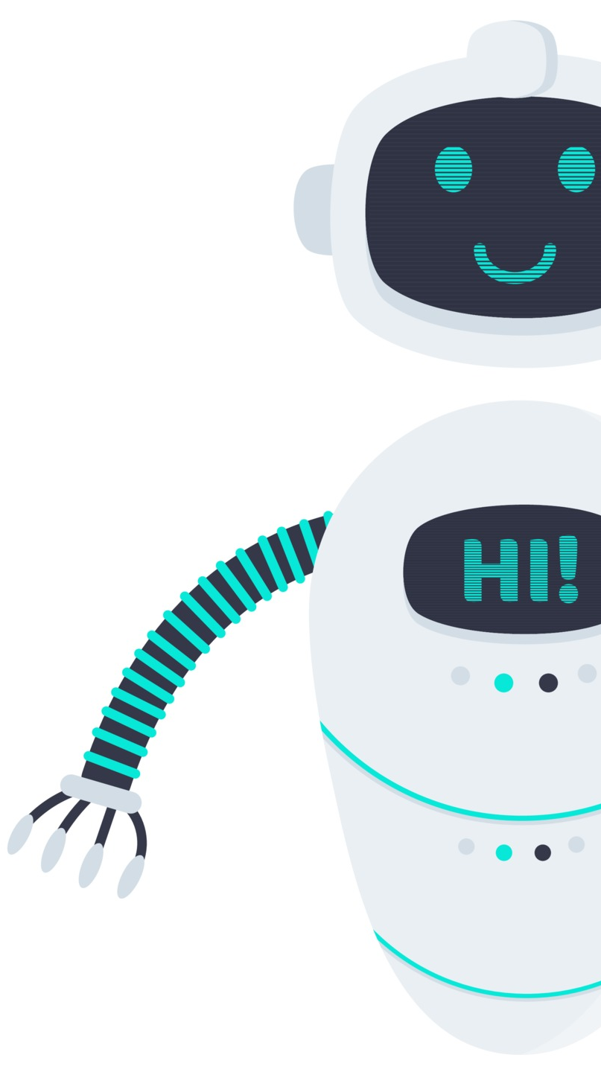
Conversational Chatbot Development with Machine Learning
Develop a Machine Learning based Conversational Chatbot with NLTK
Packages Installation
Creating Corpus with Python
Text Preprocessing and Helper Function Deployment
Generating Responses
Implementation of term-frequency times inverse document-frequency
Training and Testing of Rule Based Chatbot

